Slide 1
Product Strategy
of
Mitron Bank

Slide 2
1
Occupation
CONTENTS
2
Gender
3
Age Group
4
Marital Status

Slide 3
01
Demographic classification

Slide 4
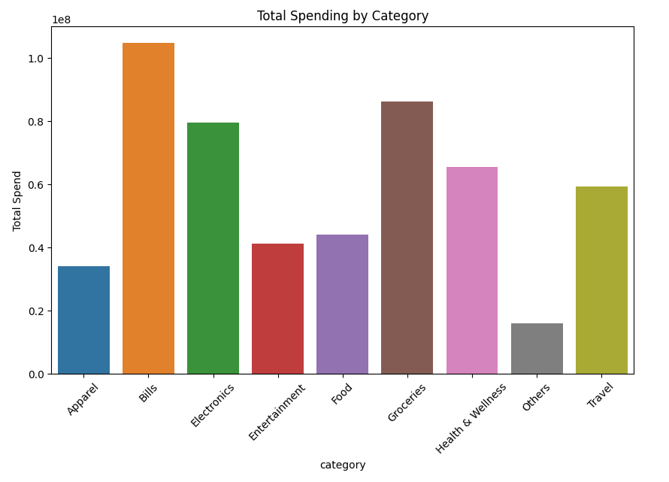
Demographic classification:
We have to Classify the customers based on available demography such as age group, gender, occupation etc. and provide insights based on them
Total Spending by category:
In this graph we can see that Bills category
is contributing more in spending of the people

Slide 5
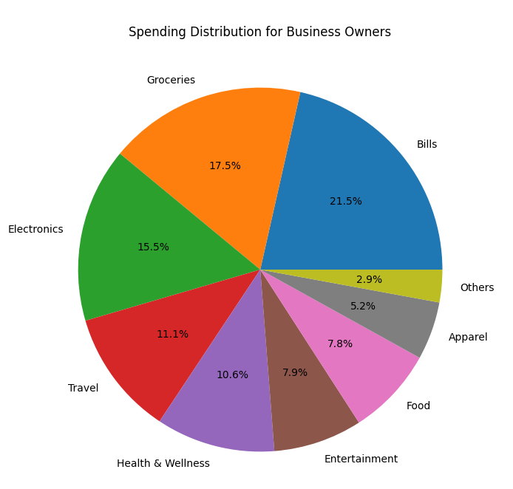
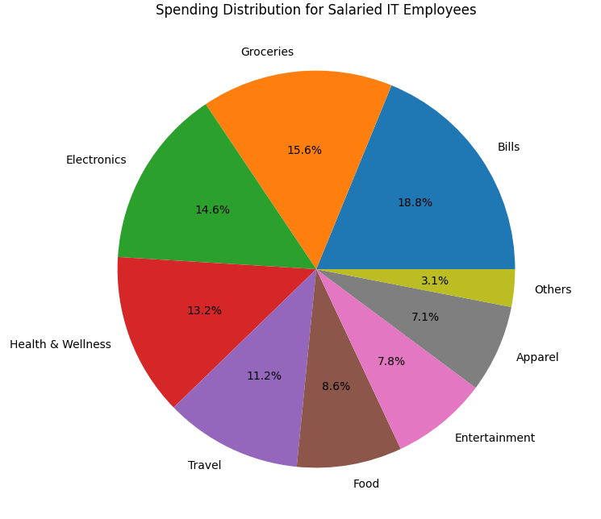
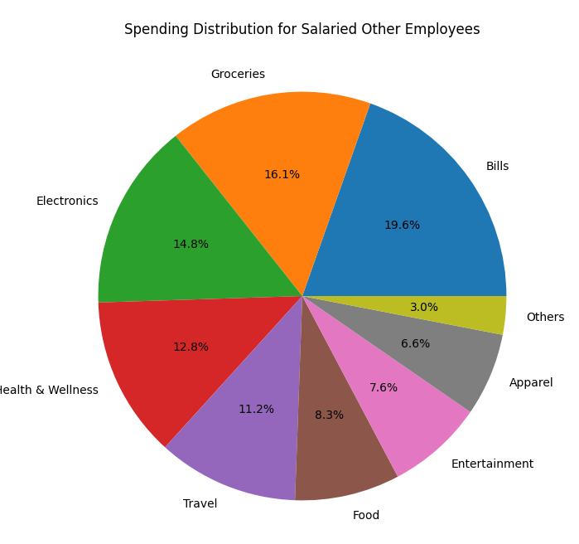
Classification by different occupation

Slide 6
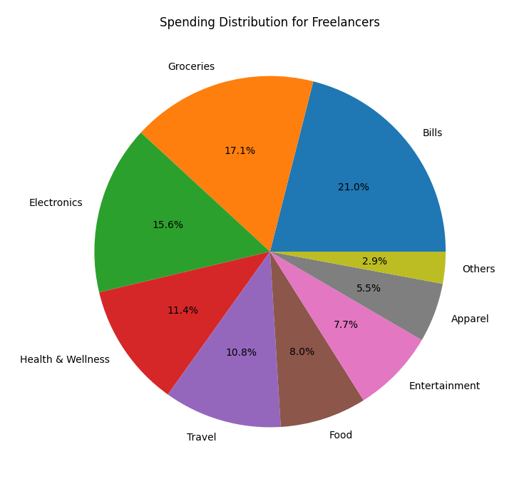
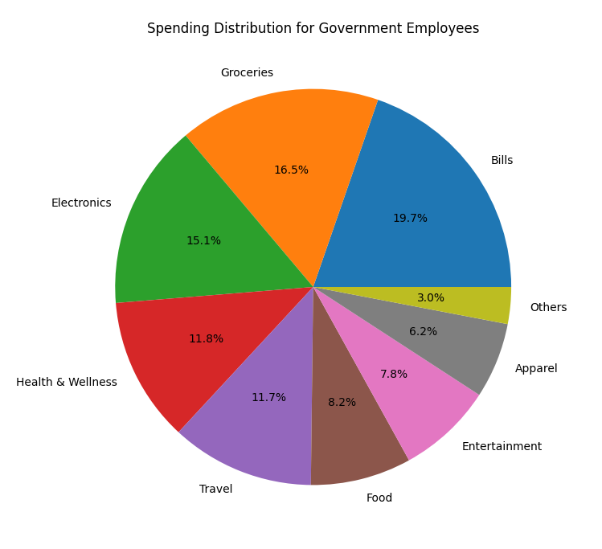
In each occupation mainly Bills, Groceries, and Electronics are major factors of spending

Slide 7
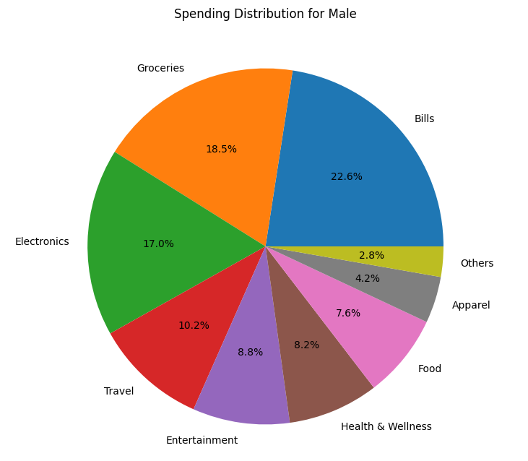
Spending Distribution as per Gender
From above chart we can see that Male first three priority spendings are
1) Bills
2) Groceries
3) Electronics

Slide 8
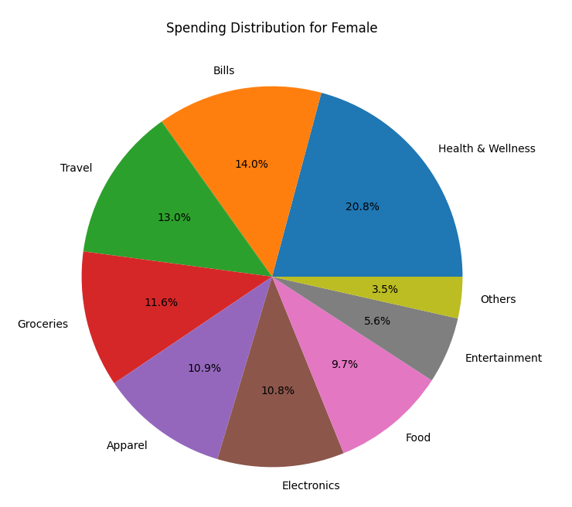
Where as Girls spending are:
1) Health and Wellness
2) Bills
3) Travel

Slide 9
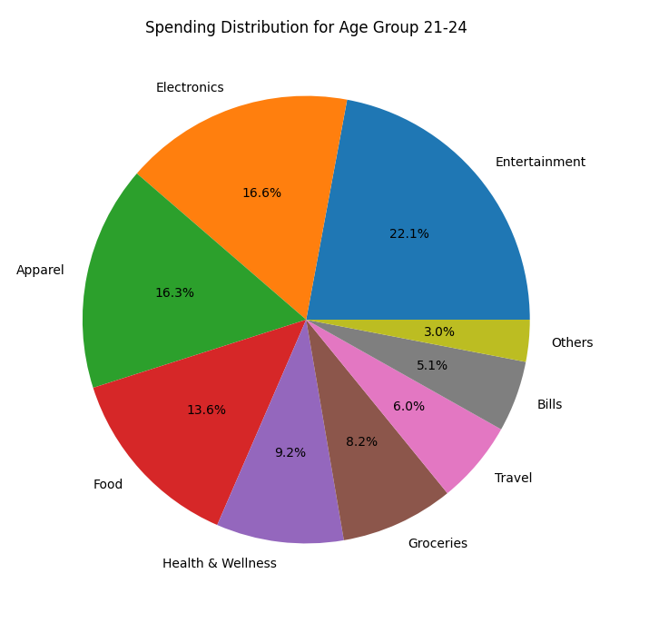
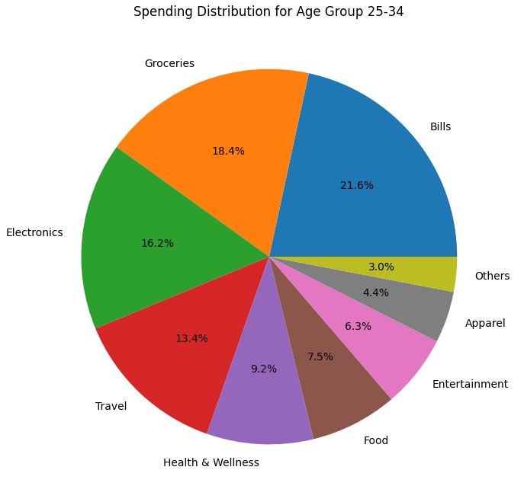
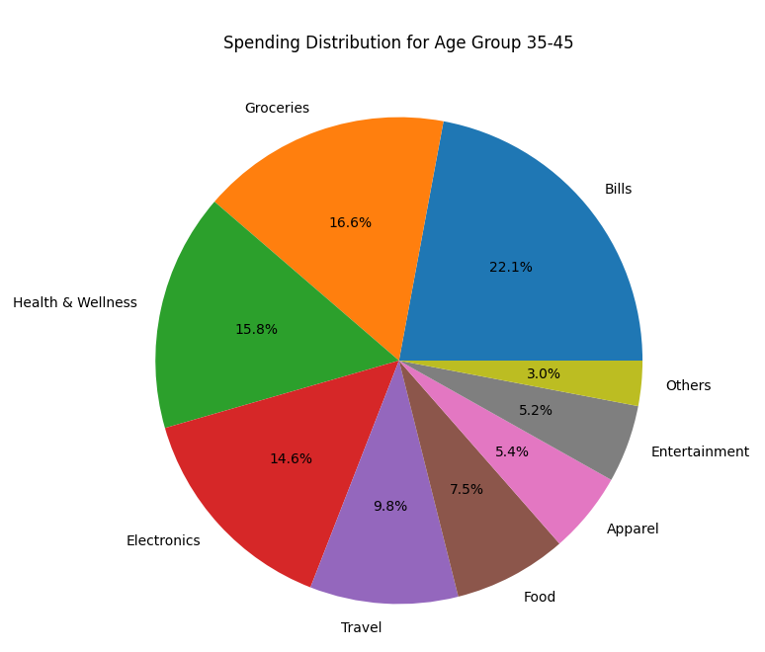
Spending distribution as per age group

Slide 10
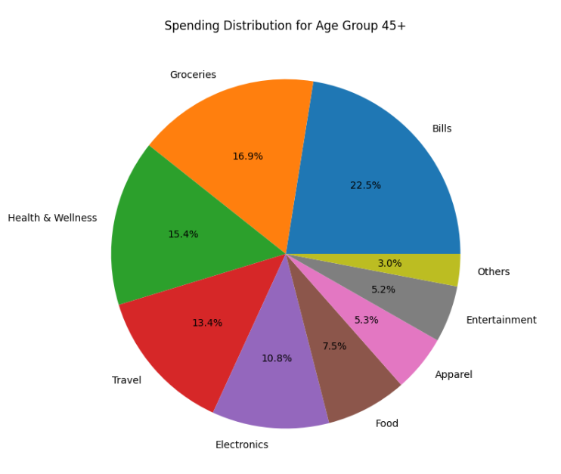
Different age group also have their different need:
Age group 21-24
1) Entertainment
2) Electronics
3) Apparel
Age group 25-34
1) Bill
2) Groceries
3) Electronics
Age group 35-45
1) Bill
2) Groceries
3) Health and Wellness
Age group 45
1) Bill
2) Groceries
3) Health and Wellness

Slide 11
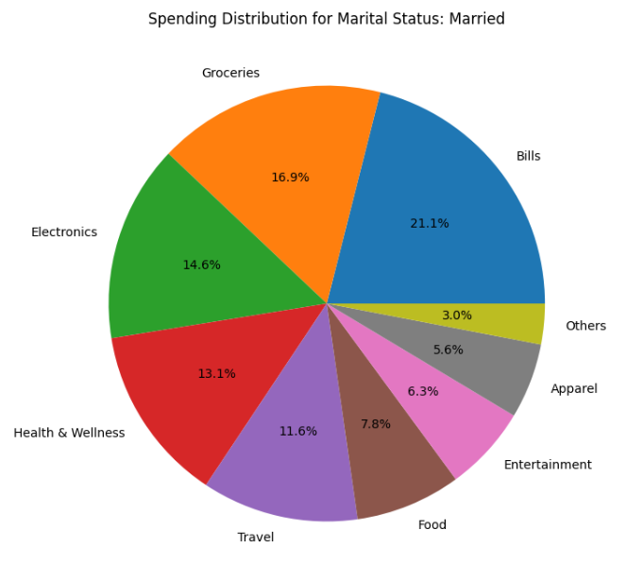
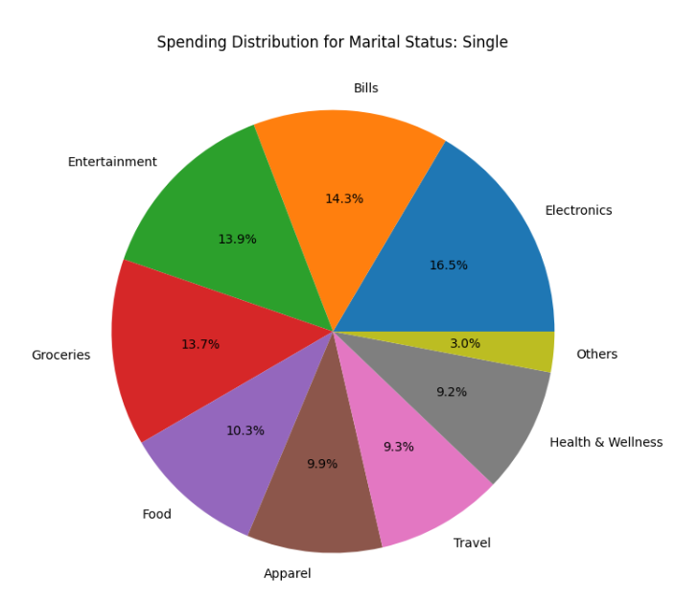
Spending Distribution as per Marital status
For Marital Ststus:
Single
1) Electronics
2) Bills
3) Entertainment
Married
1) Bills
2) Groceries
3) Electronic

Slide 12
Key Insights for credit card
1) Most of the people spending income on bill payments so we can provide cashback to attract customers.
2) In each occupation mainly Bills, Groceries, and Electronics are major factors of spending so we can also consider to give cashback on this categories also
3) Girls are mostly spending money on
Health and Wellness
Bills
Travel
So we can also offer gender based credit card where we can offer good discount on above three categories

Slide 13
Key Insights for credit card
4. Also we can target specific age group where we can offer special categories of credit card
like 21-25 age group, they are spending more money on Entertainment

Slide 14
THANK YOU

